Slide 1
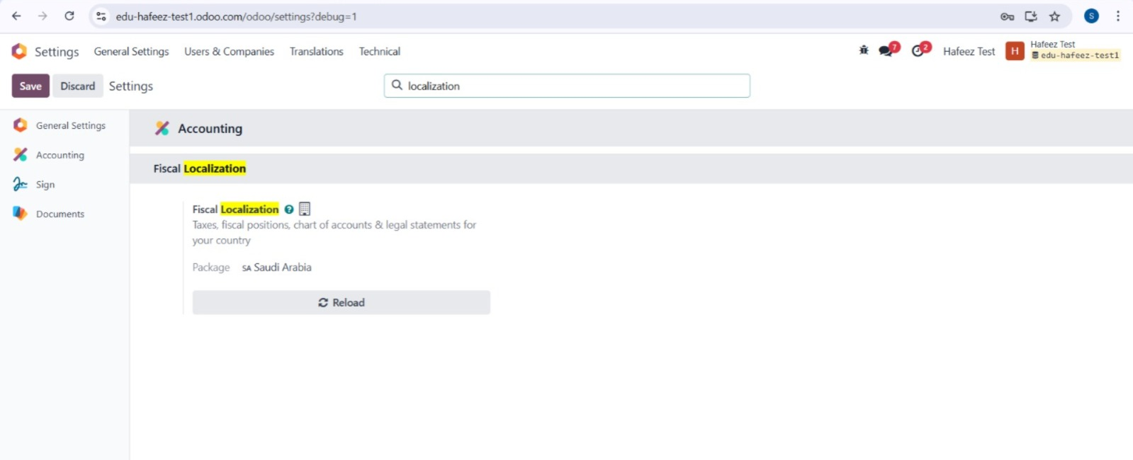
Localization

Slide 2
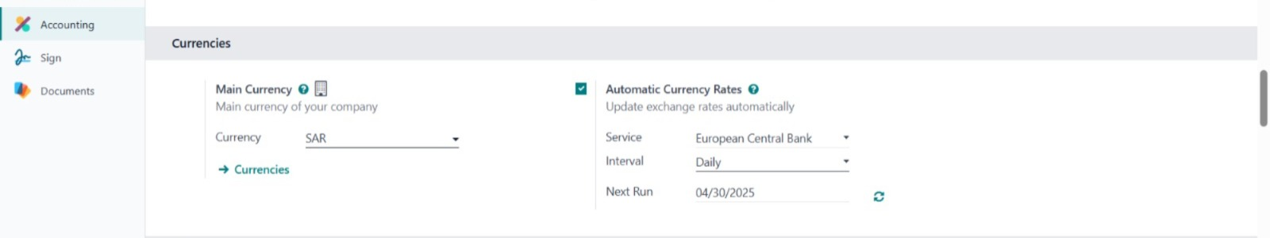
Currencies Setup
Auto foreign currency setup
to convert automatically according to the central bank's rate

Slide 3
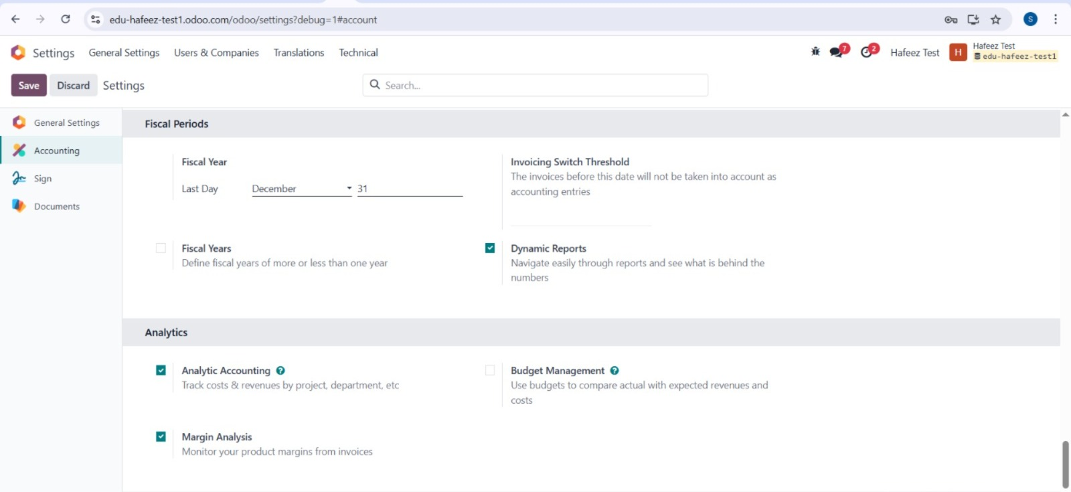
Fiscal Period & Analytics Accounts Activation

Slide 4
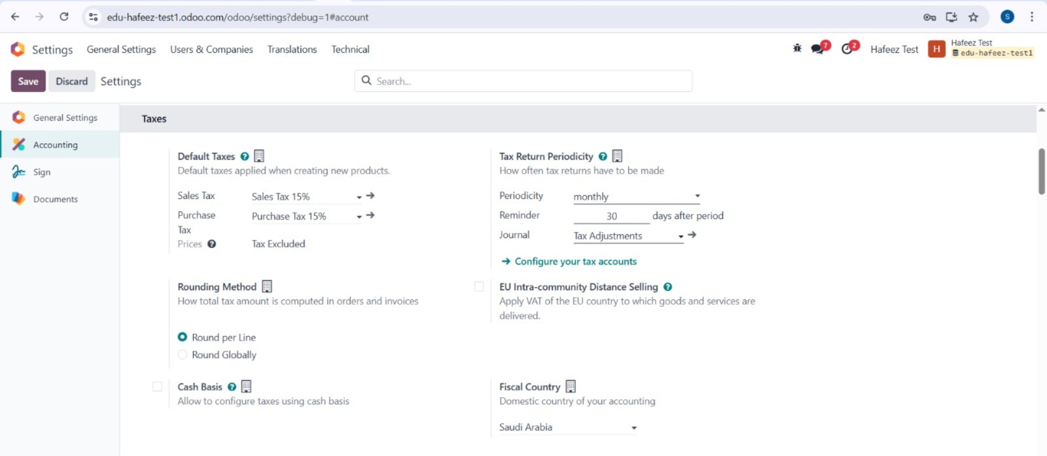
Tax setup
aligned with
country regulations
chart of accounts (COA)
aligned with

Slide 5
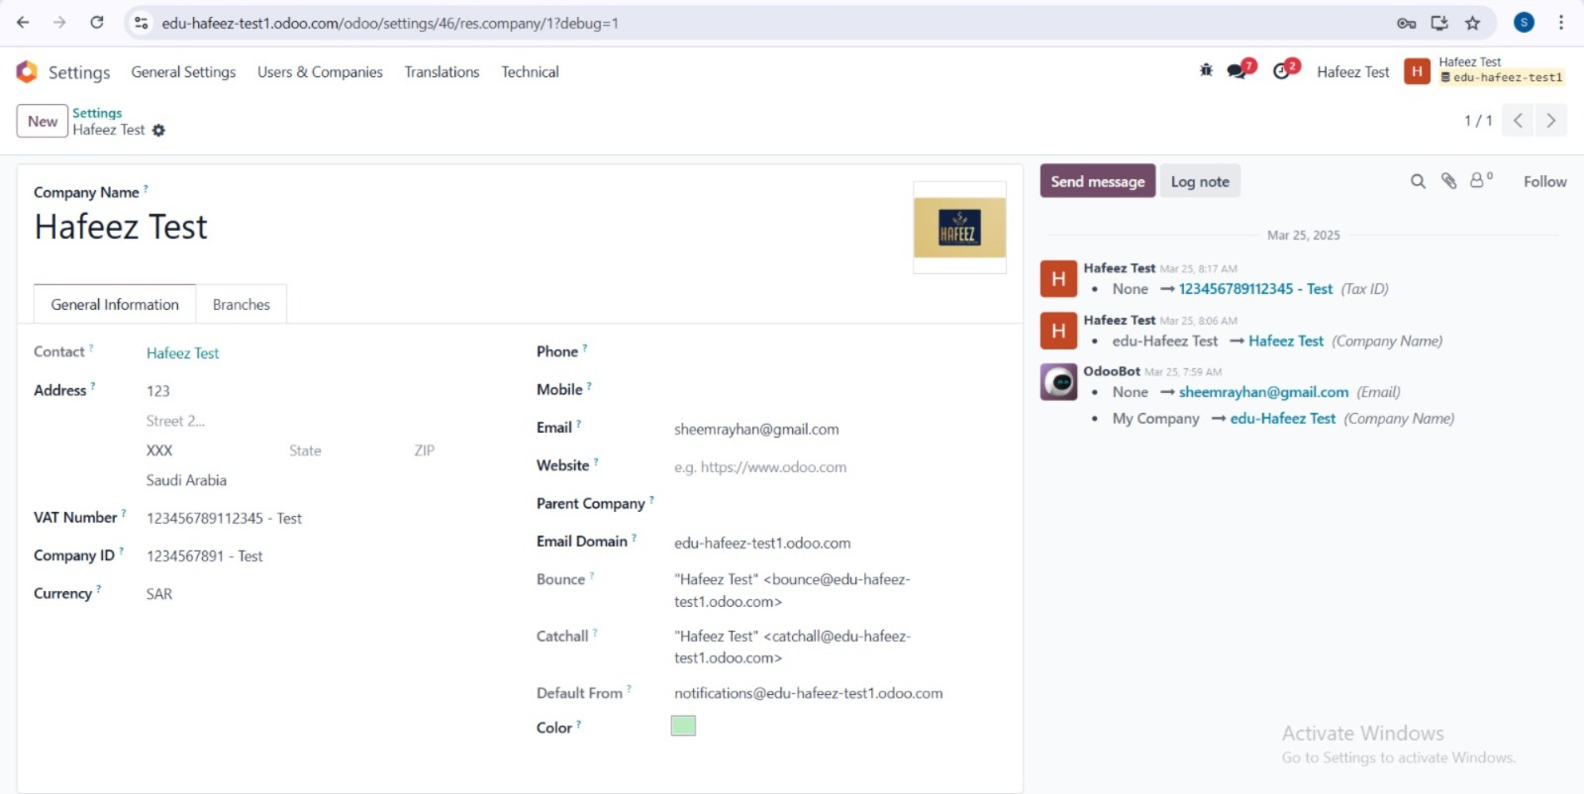
Company Info

Slide 6
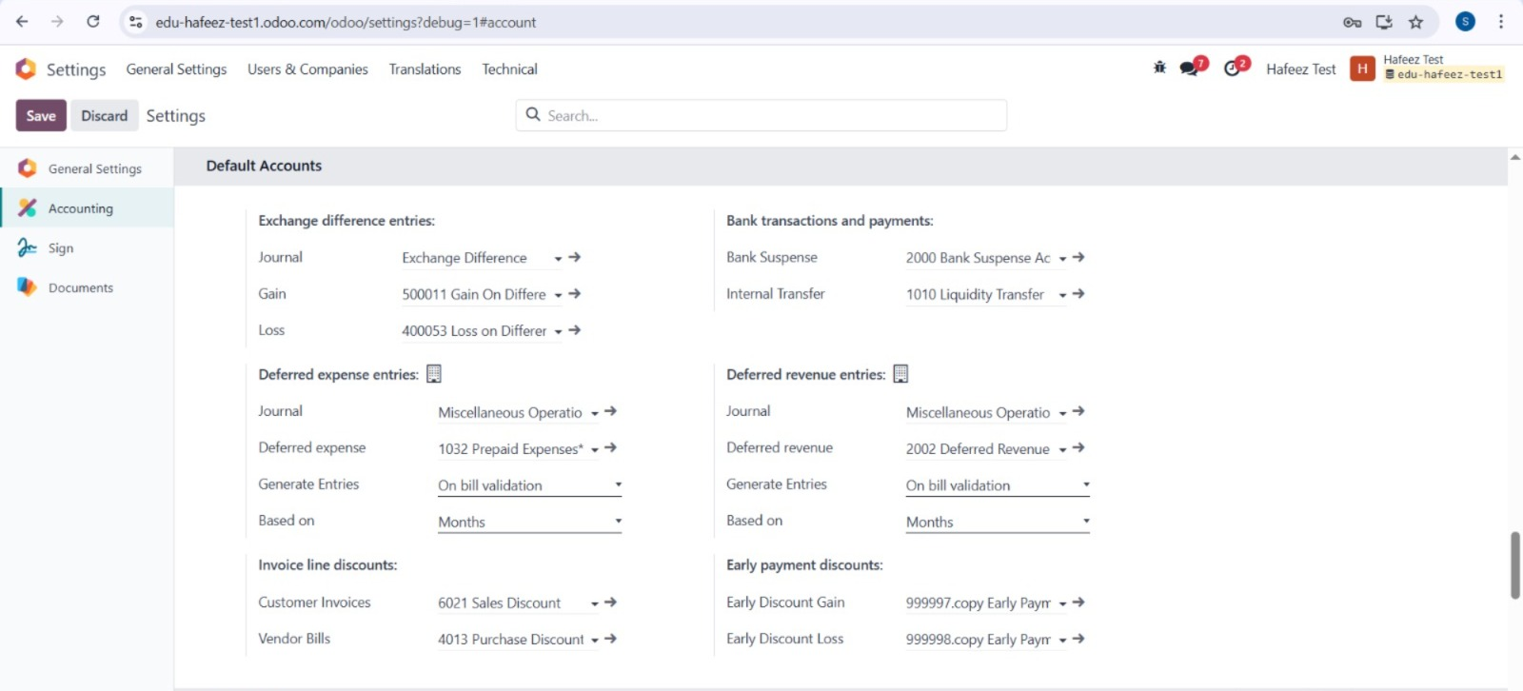
Basic Accounts & Journal Configurations

Slide 7
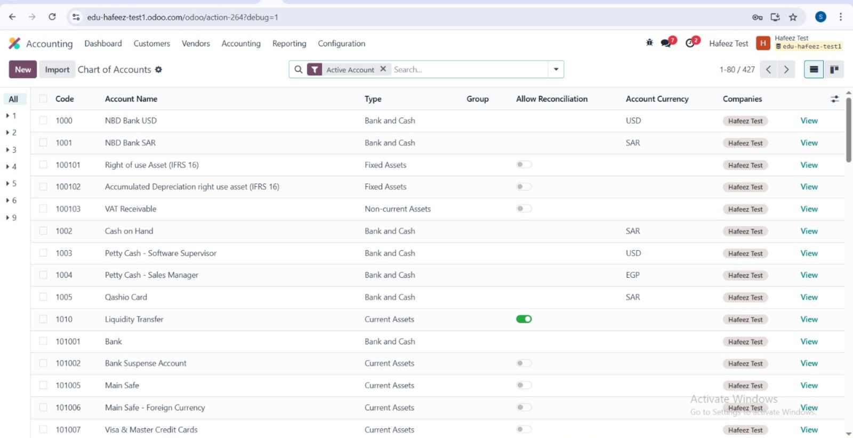
Chart of Accounts Creation
tailored to
Business structure
Reporting needs

Slide 8
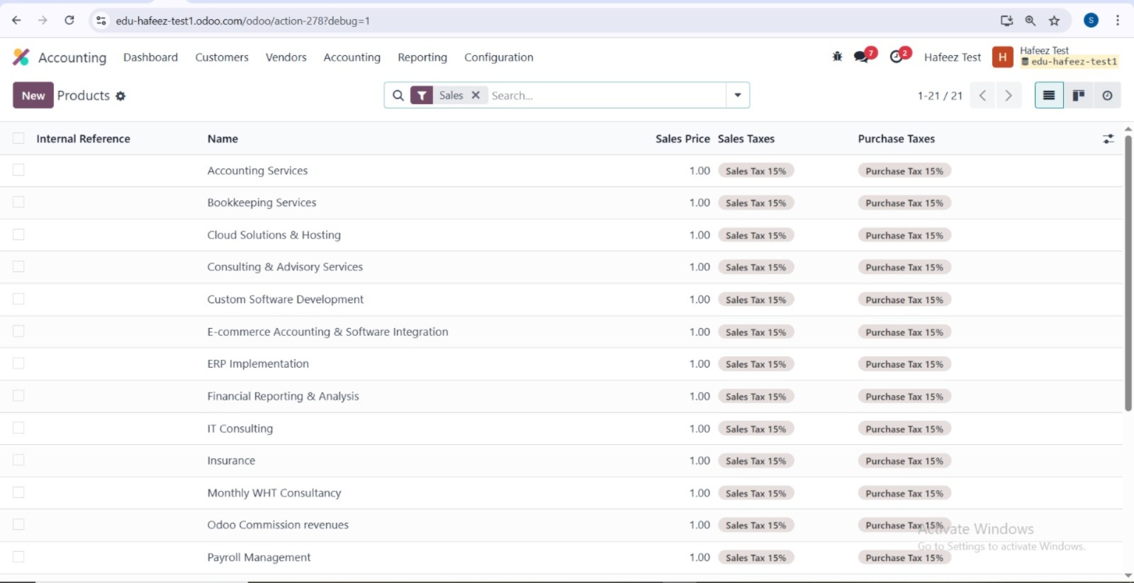
Product & Service Definition
What We Provide

Slide 9
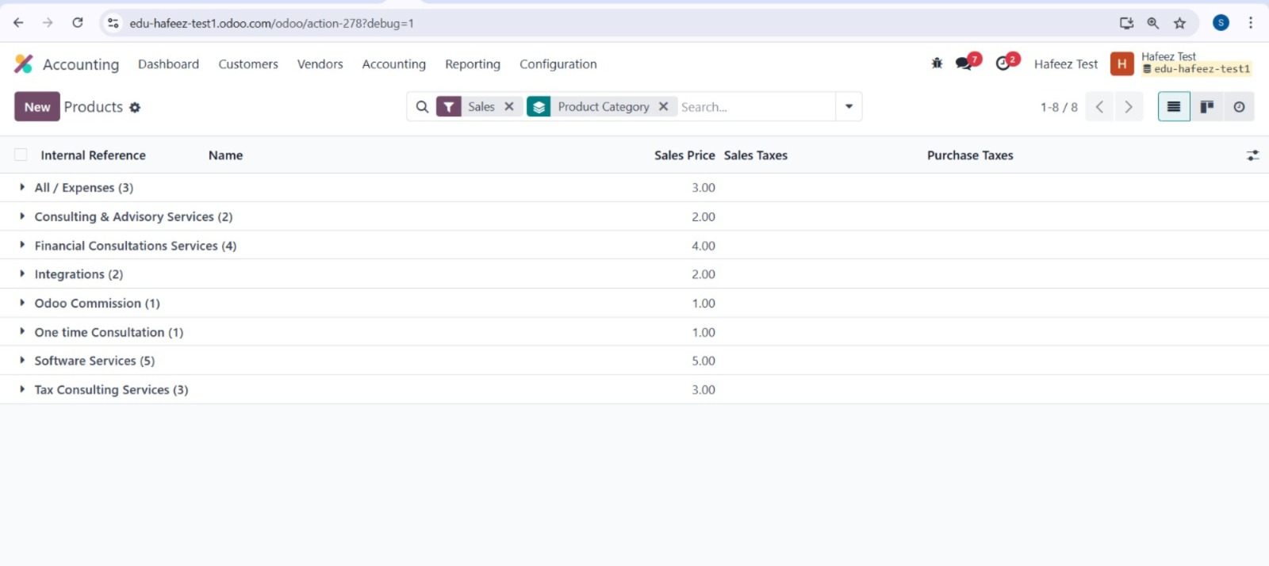
Categorize products
for better reporting and filtering

Slide 10
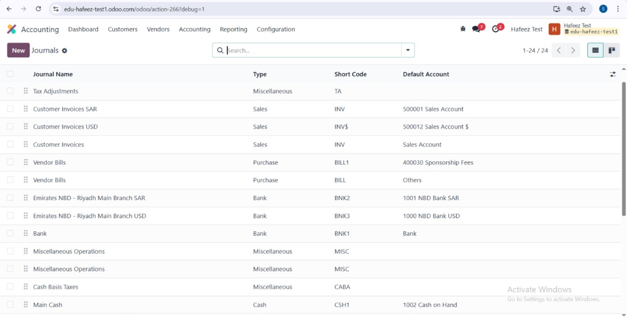
Configure Journals

Slide 11
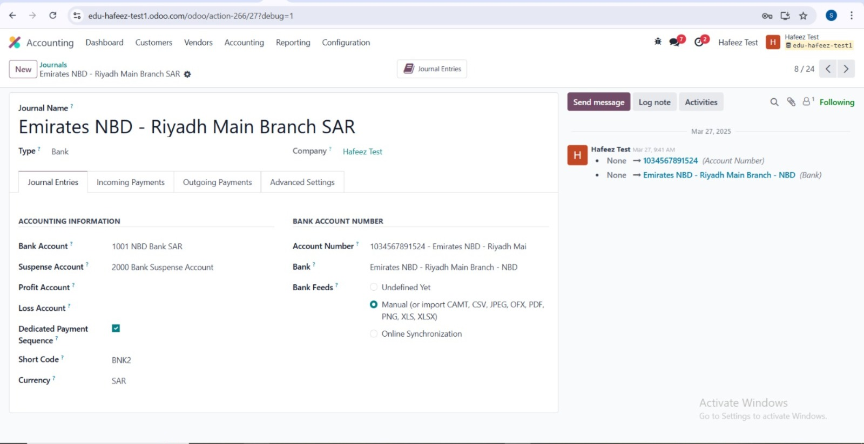
Bank Journal Configurations

Slide 12
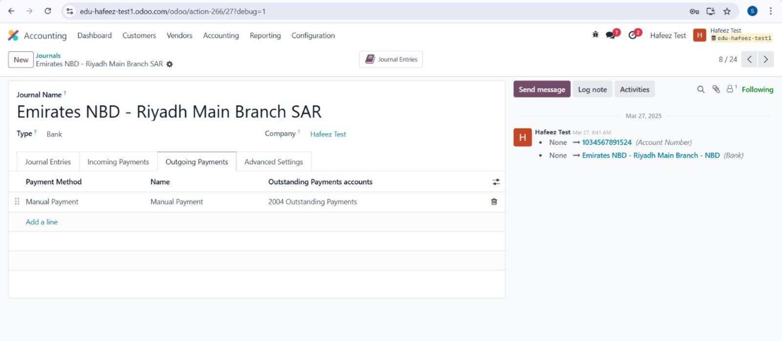
Incoming Payment Configuration

Slide 13
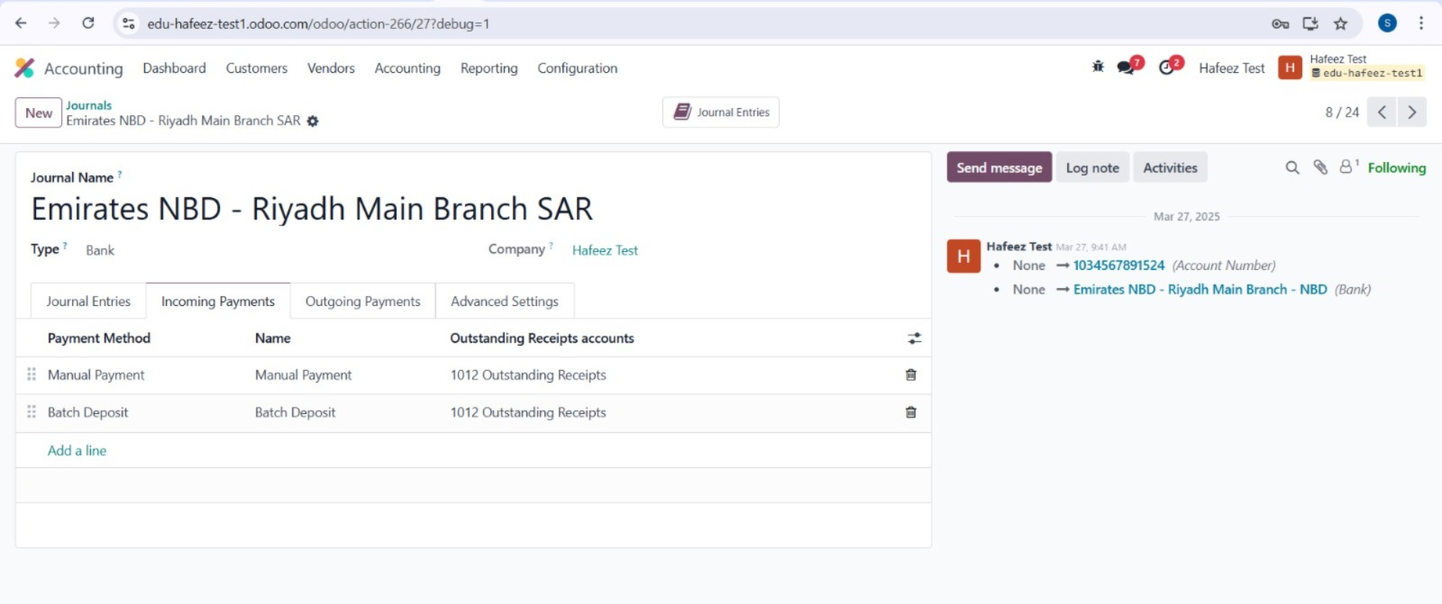
Outgoing Payment Configuration

Slide 14
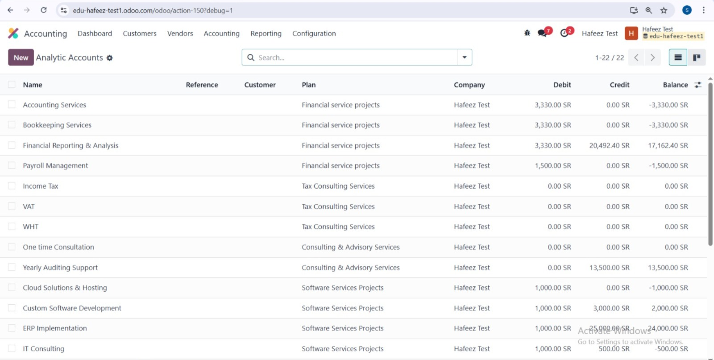
Create Analytic Accounts for each project

Slide 15
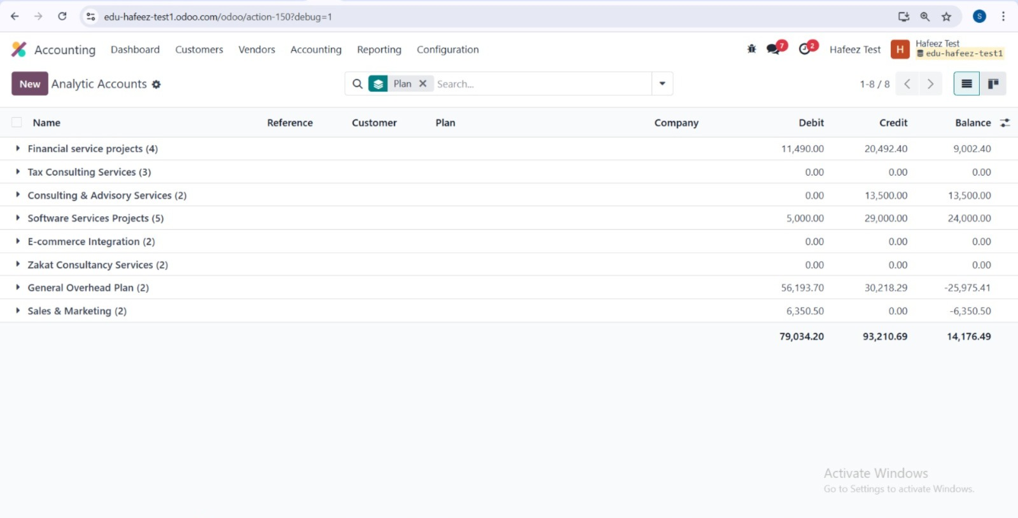
Analytic plans
that reflect
Categorize analytic accounts into plans
Your business goals and reporting structure

